Slide 1

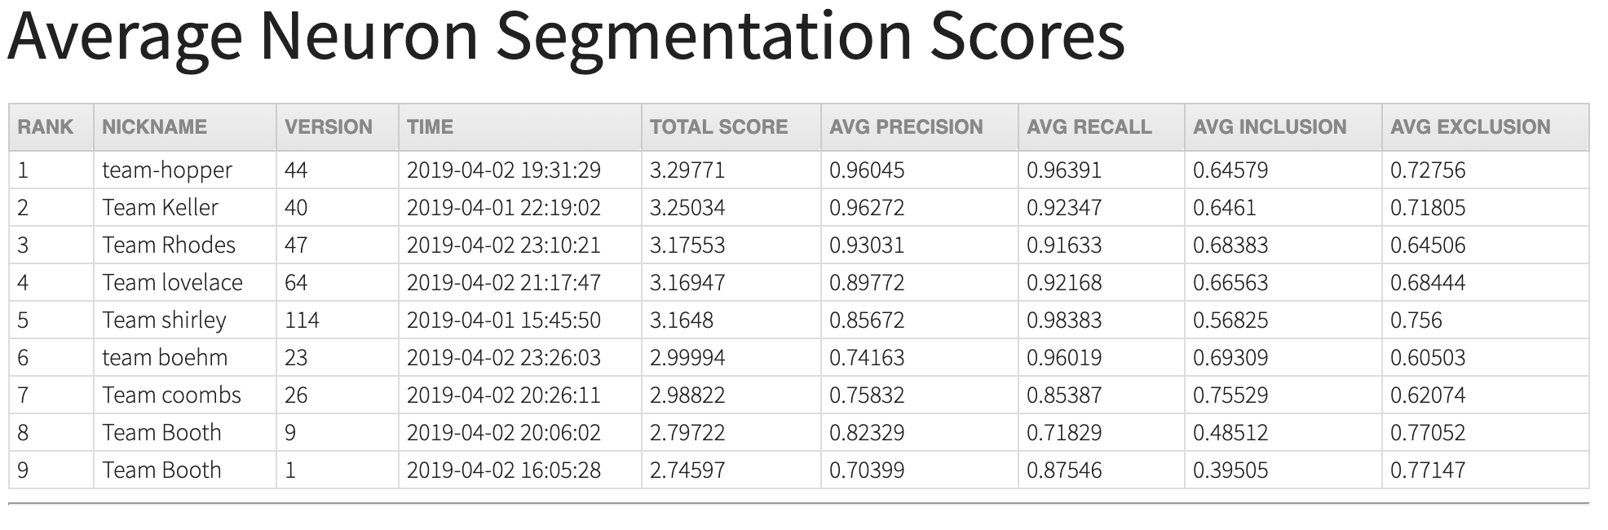
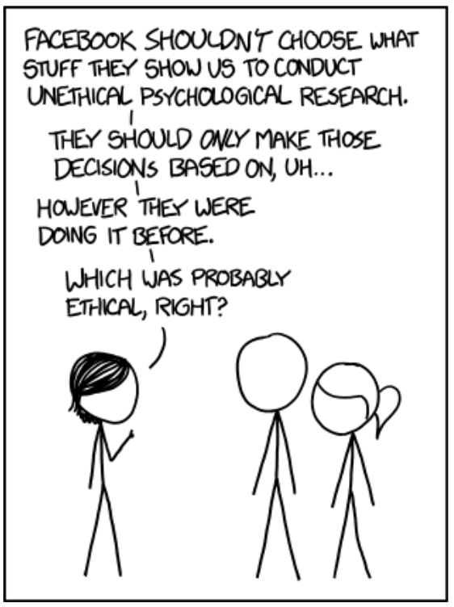
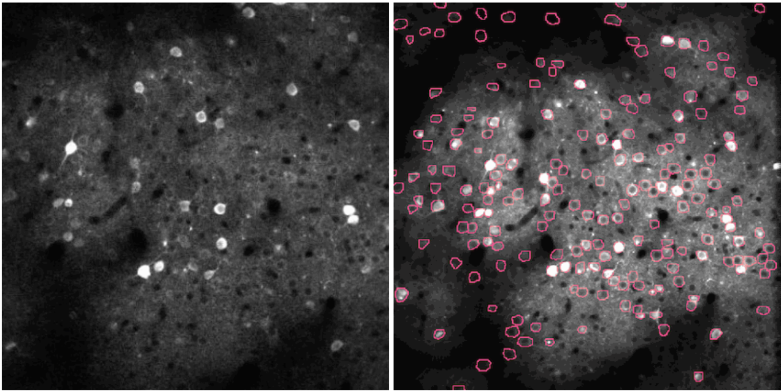
Teaching ethical data science through real-world re-enactment
Shannon Quinn
Department of Computer Science; Department of Cellular Biology University of Georgia
ABSTRACT
EXPERIMENTAL DESIGN
QUESTIONNAIRE AND SURVEY RESULTS
CONCLUSIONS and RECOMMENDATIONS
Data science as a discipline has arguably become the profession of the last decade, as evidenced by six-figure starting salaries in industry and scrambles in academia to build curricula around the field. However, due to a veritable perfect storm of cultural, logistical, and financial constraints, we are only just becoming aware of the huge ethical impact these deep societal integrations of automated decision-making can have on our daily lives. From the embarrassing (members of Congress being flagged by Amazon’s facial recognition as convinced felons) to the political (reinforcement of fringe beliefs through automated content recommendation on social media) to the life-changing (being denied a mortgage due to biased, if not outright racist, historical data) to the life-threatening (self-driving cars failing to recognize pedestrians with different skin tones), algorithms built by inherently biased individuals and trained using biased historical data have more potential than ever to perpetuate and codify existing unethical behavior and beliefs. Contrary to the Silicon Valley ethos of “move fast and break things,” ethical considerations and deference is not something that can simply be bolted on at the end; rather, it must be incorporated robustly and considered at each step of the project and drawn upon from a thorough background of ethical education.
CSCI 8360 Data Science Practicum is an annual, graduate-level course run as “Kaggle in the Classroom”: it consists of a handful of group projects focused around answering a singular data science question. How the groups arrive at solutions is entirely up to them. At the end, their solutions are submitted to a job server that checks them against a “hidden” validation dataset and generates a leaderboard of the best submissions.
Here, the course was modified to include an explicit ethics component.
First, a lecture on ethical considerations was given to the students, simulating the more “traditional” pathway to ethical education.
Second, the students were assigned a task to design an algorithm which accurately identified neurons in brain scan data while balancing the ethical considerations discussed in class. The students were given a questionnaire to follow for each step of the process, and were surveyed at the conclusion of the project.
The questionnaire was generated using deon, a Python-based commandline tool for generating ethics checklists. Five main sections with a variety of targeted questions comprised these checklists:
Data Collection: Were study subjects given informed consent? Were sources of data collection bias identified? Were steps taken to limit exposure of personally identifiable information?
Data Storage: Has the data been protected from theft? Are the subjects afforded the right to be forgotten?
Analysis: Have blindspots in the analysis been addressed? Are the figures honest representations of the data and analyses? Is the process of generating the results reproducible and transparent?
Modeling: Is there fairness across groups? Can the model and its predictions be explained? Are shortcomings of the model adequately identified and communicated?
Deployment: Have unintended uses of the model been identified? Are there contingency plans for redress if unforeseen ethical compromises are identified? Is there a way to rollback the model if necessary?
The data were acquired from HHMI Janelia Research Labs as part of their CodeNeuro competition. The data consist of multiple independent time-series image datasets (left), with accompanying metadata that indicate the spatial regions containing neurons (right).
24 graduate UGA students in Computer Science and Artificial Intelligence (M.S. and Ph.D.) participated in this study.
Have you taken an ethics course before?
22 no, 2 yes
CSCI 3030 (undergrad)
If not, why not?
Vast majority either were not aware of ethics training or had no course options
No graduate ethics courses in CSCI exist
BEFORE doing this project, had you ever considered the ethical implications of any of your data science projects?
13 yes, 11 no
Most common (and nearly only) example of previous ethical consideration is providing for user and data privacy
Do you anticipate bringing ethical considerations into your future data science projects?
95.8% (23) yes
4.2% (1) not sure
Primarily through use of the ethics questionnaire, but other common answers included more emphasis on data exploration to identify bias
Do you feel it’s important to consider the ethical implications of data science work?
100.0% (24) yes
How informative was the lecture on ethics in data science?
The intent for the final project was to illustrate a real-world
example of ethics in data
science. Would you agree that
it performed its function?
Other comments?
“The class material and presentation were so interesting and the practice on project 3 was good.”
“I think it was nice to include ethics as part of the course.”
“I valued the ethical element, but many items felt outside the scope of the project itself, and clear good examples were lacking.”
“It was a bit unusual answering the questions using a hypothetical situation. We could just answer yes to a question, without knowing how much effort actually goes into adhering to it. Suggestion: In the final project, students must collect and use their own data. The would make the project more 'real-world' and give a better understanding of the ethics that go into it.”
“A few more hands-on examples on the possible ways of considering the ethical implications would be a great way to get everyone on board and make considering ethical implications an important and necessary step instead of a developer's choice.
From this course, it is clear that that interest and enthusiasm for ethical considerations of data science exist. The primary hurdles at this stage to robust education in ethical data science is dearth of opportunity and high opportunity cost. Furthermore, it is clear that hands-on examples using real-world case studies or self-driven projects (as in this practicum) are superior from an educational standpoint.
To this end, we propose the following recommendations:
1: Development of a graduate-level ”Ethics in AI” course. This should be a field-agnostic consideration of ethics in the broad context of artificial intelligence and how it can affect, alter, and change our daily lives.
2: Incorporate ethics modules into AI related courses. These modules should focus on real-world examples of ethical considerations in the specific context of the courses, giving students an opportunity to learn by doing.
3: Form an interdisciplinary focus group on ethical research and teaching in AI. The Institute of Artificial Intelligence would be an ideal venue for forming this focus group, given its reach across both technical and fine arts departments.
BACKGROUND
The primary goal is to consider and avoid unintended consequences.
Current best practices for ethical AI research entail a four-pronged strategy.
Education
Coursework exploring the fundamental tenets and philosophy of ethics
Investigate modes of opacity of machine learning algorithms (secrecy, literacy, scale)
Potential harms of fully-automated decision-making (individual/collective, illegal/unfair)
“Dual-use” technologies (civilian technology with potential military applications)
Communication
Codes of Ethics (organizational, events, institutional)
”Ethical Considerations” as part of every publication
Broader standardization of communication with respect to AI-related datasets and services
Distribution
Approval and Terms of Access for datasets, code, and AI models
A “Responsible AI License” for code and pre-trained models
Creation, use, and distribution of tools to detect bias and explore datasets with explicit ethical considerations
Advocacy
Obtain and promote diverse research and instructional perspectives
Bring ethical concerns to the forefront (classes, meetings)
Include ethical considerations in course syllabus
Large (institutional) and small (student orgs) advocacy initiatives
REFERENCES
Buolamwini, Joy, and Timnit Gebru. "Gender shades: Intersectional accuracy disparities in commercial gender classification." In Conference on Fairness, Accountability and Transparency, pp. 77-91. 2018.
Friedler, Sorelle A., Carlos Scheidegger, Suresh Venkatasubramanian, Sonam Choudhary, Evan P. Hamilton, and Derek Roth. "A comparative study of fairness-enhancing interventions in machine learning." In Proceedings of the Conference on Fairness, Accountability, and Transparency, pp. 329-338. ACM, 2019.
Glymour, Bruce, and Jonathan Herington. "Measuring the Biases that Matter: The Ethical and Casual Foundations for Measures of Fairness in Algorithms." In Proceedings of the Conference on Fairness, Accountability, and Transparency, pp. 269-278. ACM, 2019.
Hutchinson, Ben, and Margaret Mitchell. "50 Years of Test (Un) fairness: Lessons for Machine Learning." arXiv preprint arXiv:1811.10104 (2018).
“Amazon Is Pushing Facial Technology That a Study Says Could Be Biased”, https://www.nytimes.com/2019/01/24/technology/amazon-facial-technology-study.html
https://xkcd.com/1390/
ACKNOWLEDGEMENTS
I would like to thank the Center for Teaching & Learning for supporting the Lilly Teaching Fellowship program. It has been a truly transformative experience that has afforded me the flexibility to explore and pursue excellence in teaching, which is a big part of the reason I got into this line of work. I would also like to thank Dr. Joachim Walther, my Lilly mentor, who has provided invaluable advice and guidance over the past two years in all things Lilly, tenure-track, and beyond. I would like to thank our fearless leader Dr. Steven Lewis and everyone else who stepped up to lead our intrepid cohort. Last but certainly not least, I want to thank my Lilly cohort for being the beating heart of the whole fellowship experience, pushing me to view instruction from new and different perspectives and taking me outside my comfort zone when I could not see the forest for the trees.

